Slide 1
Chapter 1
Continuation

Slide 2
Things to remember
Main function – int main(void)
Its good practice to use return 0;
If you want to hold the output screen use getchar() before return. Also pause and some other function.
Align the statement(braces), really useful when writing a long coding, also its easy to track or read.
Be very clear in logic before writing the statement.
If you want to know about a function read the library in the book or web, if you are smart enough you can simply select the function->right click -> go to definitions->check the header file.

Slide 3
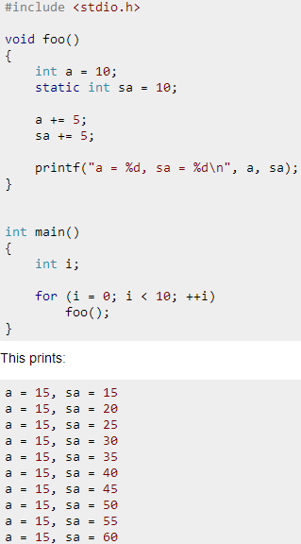
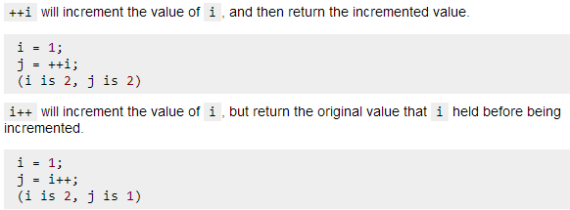
Keywords
Void – its basically nothing or no type.
Function argument: int myFunc(void) -- the function takes nothing.
Function return value: void myFunc(int) -- the function returns nothing
Static
A static variable inside a function keeps its value between invocations.
A static global variable or a function is "seen" only in the file it's declared in.
Preserves variable value to survive after its scope ends.
Volatile
It indicates that a variable may be changed in a way which is absolutely unpredictable by analysing the normal program flow (for example, a variable which may be changed by an interrupt handler).

Slide 4
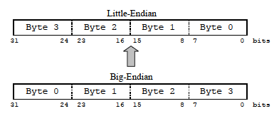
Extern
indicates that the actual storage and initial value of a variable.
usually in a separate source code module.
Register
In a computer, a register is one of a small set of data holding places that are part of a computer processor. A register may hold a computer instruction , a storage address, or any kind of data (such as a bit sequence or individual characters).
Depending on the processor design and language rules, registers may be numbered
Endian

Slide 5
Character Input and Output
The standard library handles the model of i/o.
There are several reading and writing functions, the most familiar and simplest one is getchar and putchar.
getchar() reads the next input character
Putchar(j) writes the character or number in the variable j.
It could be from one character to sequential of character or numbers.
Mostly the i/o is from the keyboard, but it can be extended to any device and by any communication.
Other functions scanf, printf, sscanf, sprintf ….

Slide 6
Character copying

Slide 7
Character, Line counting, word counting

Slide 8
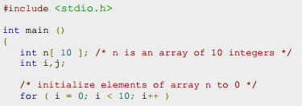
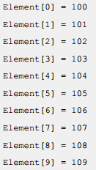
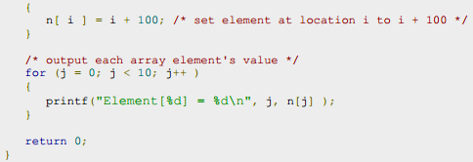
Arrays
Initialize arrays –
Accessing the array -

Slide 9
Multidimensional Array –

Slide 10
Functions
Format
Return Type: A function may return a value. The return_type is the data type of the value the function returns. Some functions perform the desired operations without returning a value. In this case, the return_type is the keyword void.
Function Name: This is the actual name of the function. The function name and the parameter list together constitute the function signature.
Parameters: A parameter is like a placeholder. When a function is invoked, you pass a value to the parameter. This value is referred to as actual parameter or argument. The parameter list refers to the type, order, and number of the parameters of a function. Parameters are optional; that is, a function may contain no parameters.
Function Body: The function body contains a collection of statements that define what the function does.

Slide 11
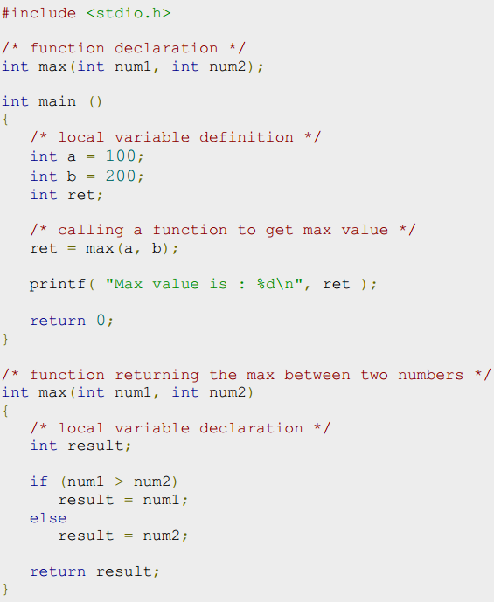

Slide 12
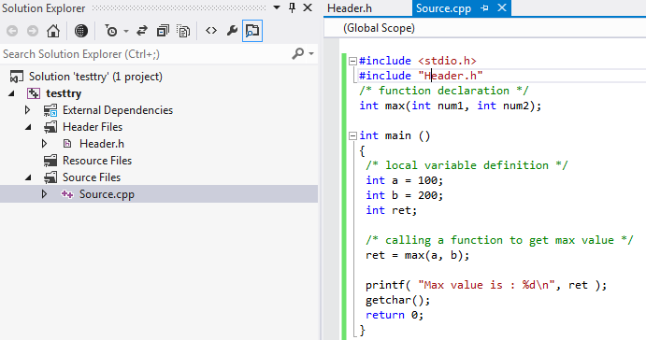
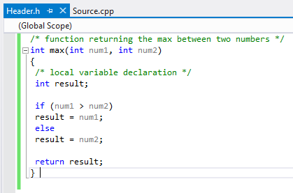
Usually when writing a c/c++ program for a bulk application try to use the functions in separate c/c++ header files/source file.
If you are using a small functions then you can write the function in same file.
This is how the header file are created.

Slide 13
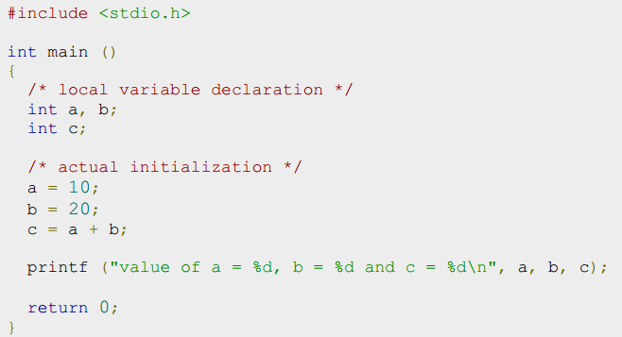
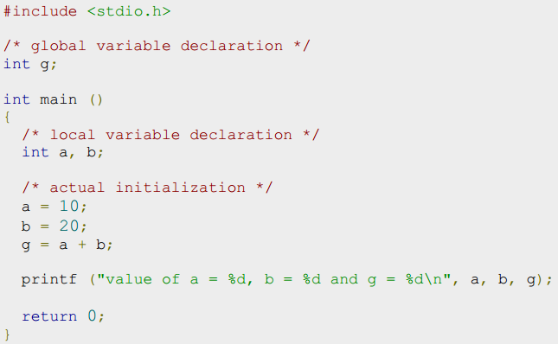
Local & Global variables

Slide 14
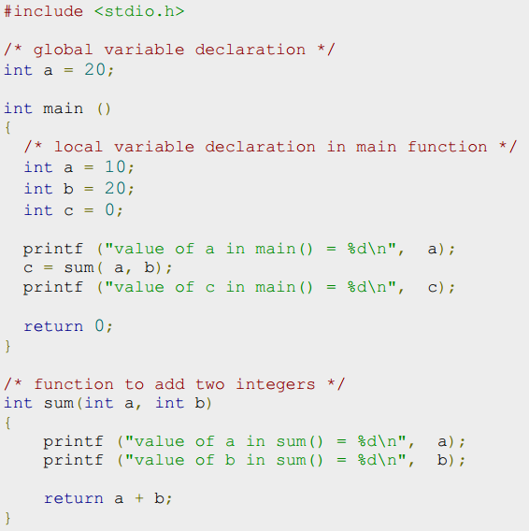
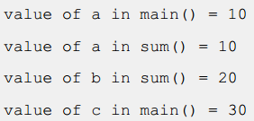

Slide 15
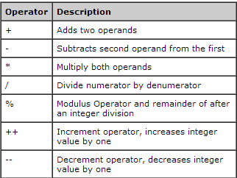
Arithmetic expressions

Slide 16
Summary
Basic structure
Overview about datatypes
Variables
Symbolic Constants
For Loop & While loop
Character inp/out
Arrays
Functions
Arguments by call

Slide 17
Study the workflow of character array program in chapter 1(in book).
Create a one dimensional array of 20 random numbers each, now separate the odd and even numbers and store the output in new array in a order of even numbers in even position and odd numbers in odd position.

