Slide 1
Chapter – 2
Types, operators and expressions

Slide 2
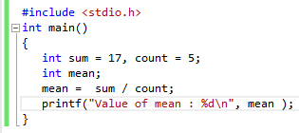
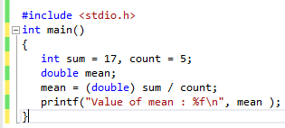
Type Conversions/Type casting
Type casting is way to convert from one data type to another data type.

Slide 3
When converting from char to int can it produce a negative integer?
Yes! It varies from machine to machine.
Some machines a char whose leftmost bit is 1 will be converted to a negative integer(“sign extension”).
On others, it is promoted to an int by adding zeros at the left end(always positive).
Arithmetic conversions
Many operators cause conversions to yield results in similar way. (usual arithmetic conversions)

Slide 4
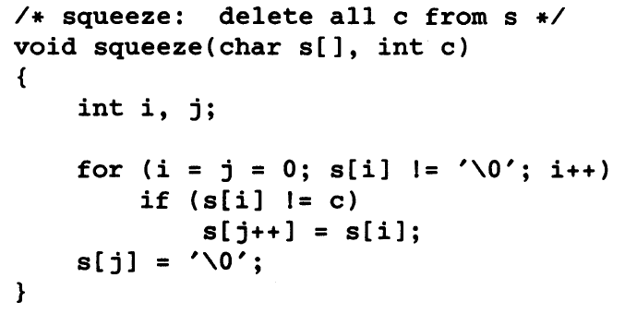
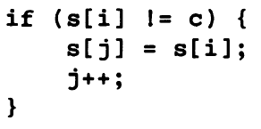
If “x” is float and “I” is int, then x = i and i = x both cause conversion but float to int cause truncation.
Increment and Decrement operators
Two usual operators – incrementing (++ adds one) and decrementing variables(-- subtracts one)
++n increments n before its value is used, n++ increments n after its value has been used.
Expression like (i+j)++ is illegal, only applies to variables.

Slide 5
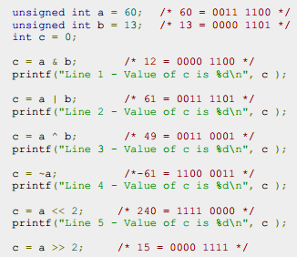
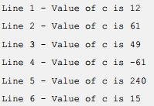
Bitwise Operators
Bitwise operator works on bits and performs bit by bit operation. & (and),| (or), ^ (xor), ~ (binary ones complement/flipping bits), << (left shift), >> (right shift).

Slide 6
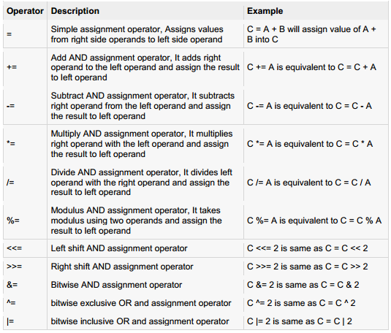
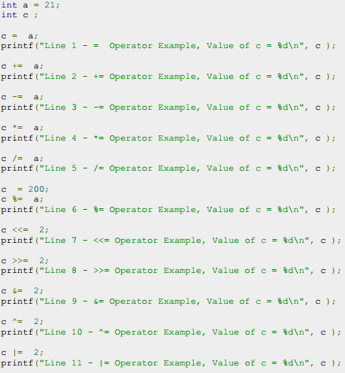
Assignment operators

Slide 7
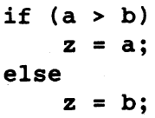
Conditional expression
The value of a ? expression is determined like this: Exp1 is evaluated. If it is true, then Exp2 is evaluated and becomes the value of the entire ? expression. If Exp1 is false, then Exp3 is evaluated and its value becomes the value of the expression.. (different types)
Summary for chapter 2
Variable names
Data types and sizes
Constants
Declarations
Relational and logical operators & precedence order
Type casting and operators.

Slide 8
Chapter - 3
Control flow

Slide 9
Decision makers in c
If statement
If…..else statement
The if ….else if …else statement
Nested if statements
Switch statement
Nested switch statements
Decision making structures requires that the programmer specify one or more conditions to be evaluated or tested, along with the statement or statements to be executed if the condition is determined to be true and optionally other statements to be executed if the condition is false.

Slide 10
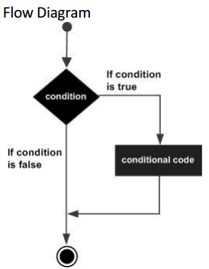
If statement

Slide 11
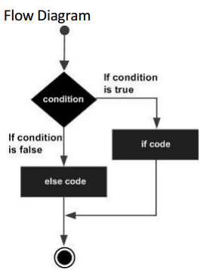
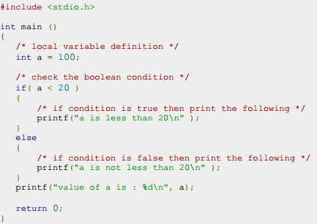
If ….Else statement

Slide 12
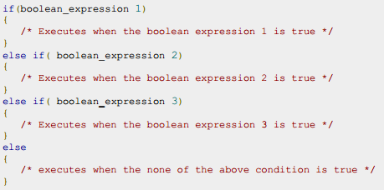
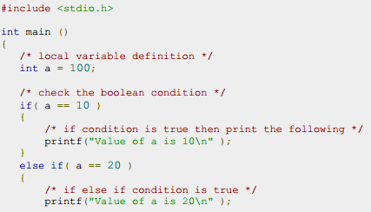
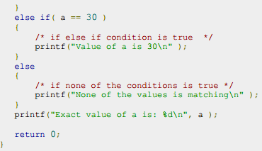
The if ….else if ….else statement

Slide 13
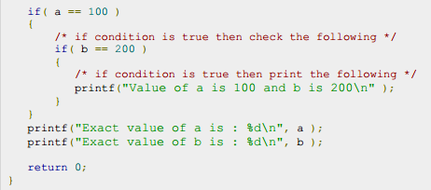
Nested If statement
It is always legal in c programming to nest if – else statement, which means one can use if or else if statement inside another if or else if statements.

Slide 14
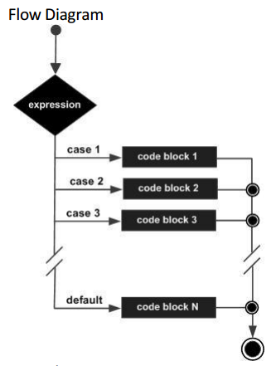
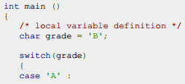
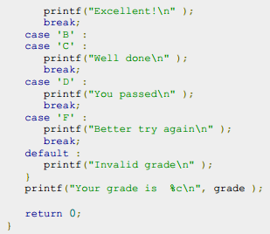
Switch statement
A switch statement allows a variable to be tested for equality against a list of values. Each value is called a case, and the variable being switched on is checked for each switch case.

Slide 15
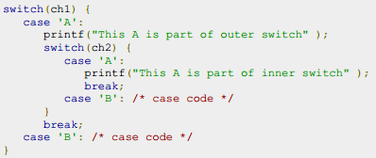
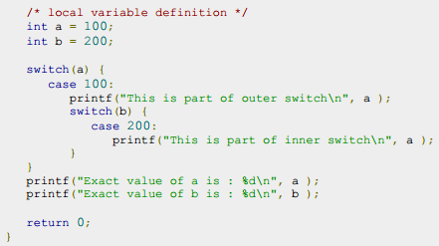
Nested switch statements
It is possible to have a switch as part of the statement sequence of an outer switch. Even if the case constants of the inner and outer switch contain common value, no conflict will arise.

Slide 16
Create a simple calculator in a following way
It should ask for the arithmetic operations (+,-,*,/)
Then enter two numbers
Calculate the results using switch case/ nested switch case(optional)
Print the results

